Slide 1
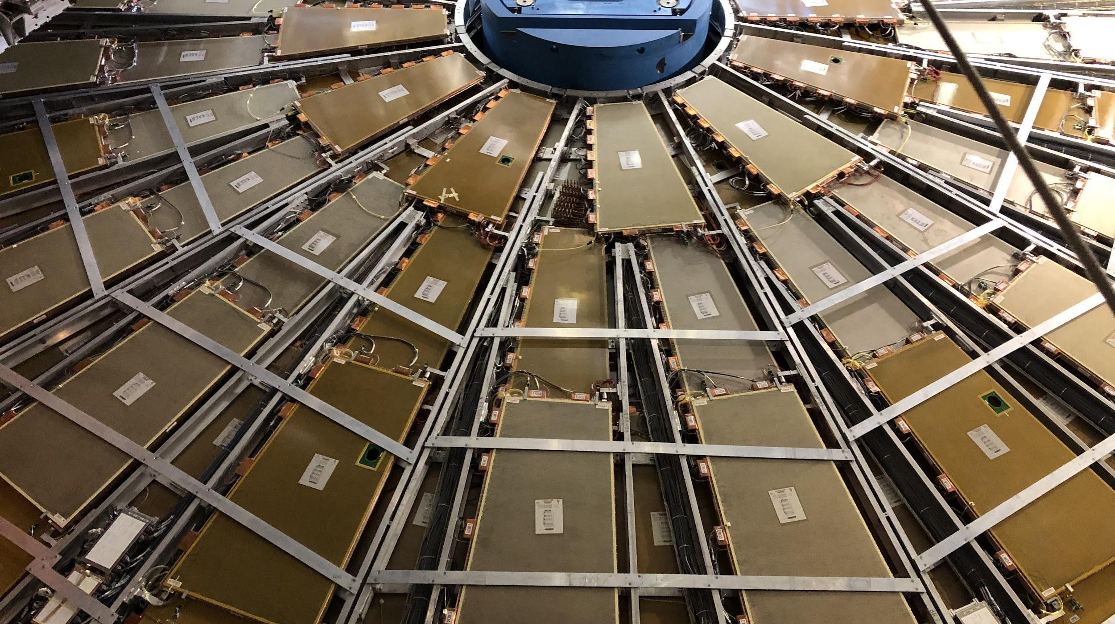

Maintenance Weekly
TileCal Op Meeting, 14 October 2021
Irakli Minashvili, Chris Thomas, Dawit Belayneh, Katie Hughes

Slide 2
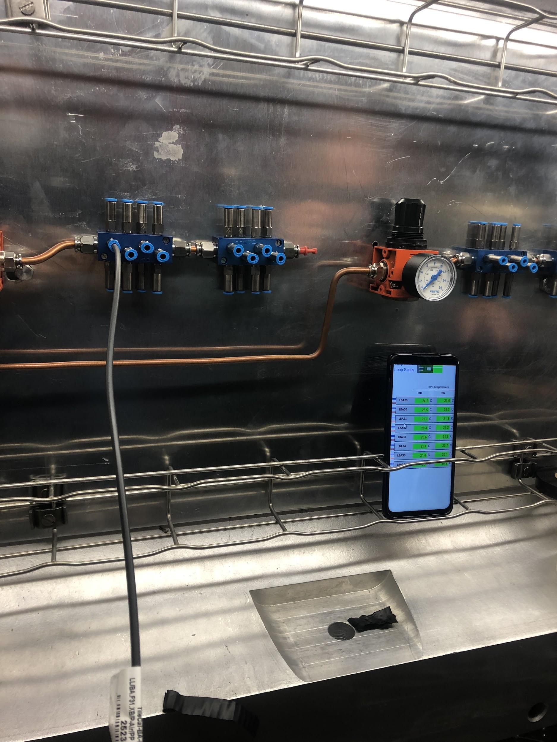
Cooling System Update
All loops on LBA and LBC have been commissioned
We check the in and out hoses for each module separately, and confirm they both increase the module’s temperature using DCS
LBC 18, LBC 51, and LBA 15 are not connected
Not sure why LBC 51 is like this, it is not blocked by a cesium garage
LBA 37 is currently locked

